Slide 1
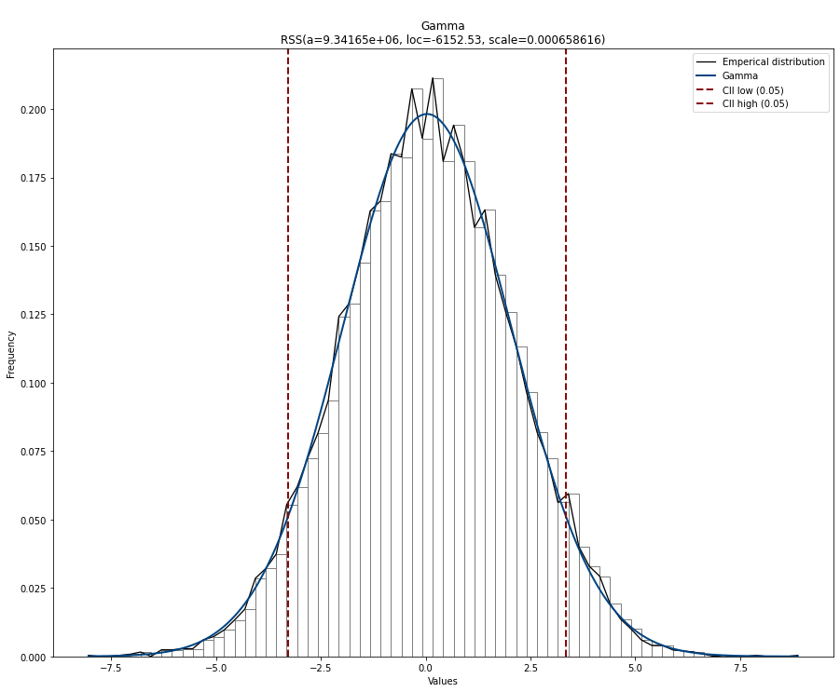
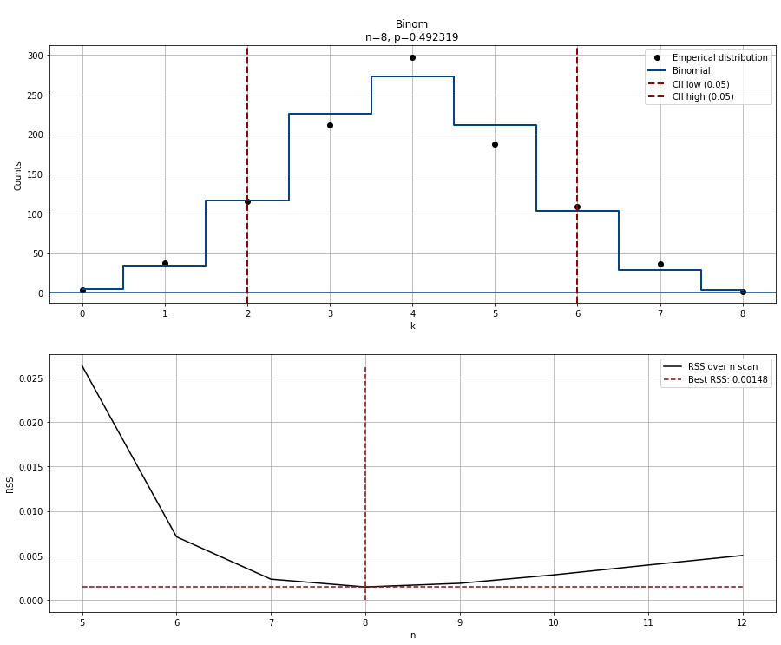
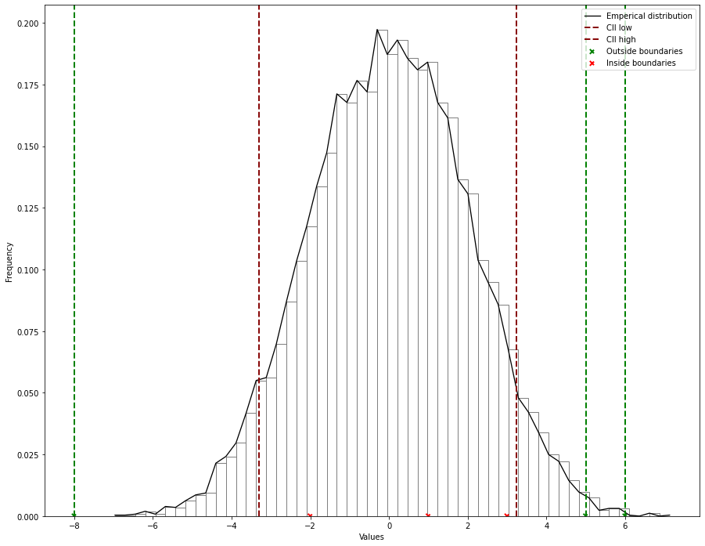
Distribution fitting
Parametric fitting
Non-Parametric fitting
Discrete fitting

Slide 2
